Slide 1
AI based Vehicle Parking System using SVM and HOG
Department of Computer Science and Engineering
Project Review
Submitted By
Swathy S 715520114052
Mugilan G 71552014031
Reshmah C S 715520104040
Guided By
Dr. D. Sivaganesan
Professor
Department of CSE
AI based Vehicle Parking System in VANET

Slide 2
Abstract
Roads are becoming increasingly intricate, with various elements such as intersections, diverse traffic patterns, and unpredictable road conditions. Recognizing the complexity highlights the need for advanced technologies to navigate and respond to dynamic situations.
The surge in the number of vehicles intensifies traffic density and the likelihood of potential hazards. Addressing safety concerns requires solutions capable of managing and mitigating risks in high-traffic scenarios.
Accurate and timely identification of obstacles is pivotal for preventing accidents, safeguarding lives, and minimizing property damage. Highlighting the pivotal role of obstacle detection underscores its direct impact on safety outcomes.
AI enables vehicles to "see" and interpret their surroundings, providing them with a heightened level of situational awareness. This enhanced perception equips vehicles to detect and respond to obstacles more effectively, significantly contributing to overall road safety.
AI based Vehicle Parking System in VANET

Slide 3
Introduction
Finding a vacant parking space in a congested area or a large parking lot, specially, in peak hours, is always time consuming and frustrating to drivers. It is common for drivers to keep circling a parking lot and look for a vacant parking space.
To minimize hassle and inconvenience to the drivers, many parking guidance systems have been developed over the past decade, where the system provides accurate, real-time car park space availability to the drivers looking for parking spaces and then guides them to the available spaces by dynamically updated guide signs.
The current parking guidance systems obtain the availability of parking spaces using the sensors installed across the whole parking lot. However, deploying sensors in a large parking lot can be very expensive and inaccurate.
If the driver have the up-to-date knowledge about the traffic situation like information about the free parking place near the destination area it would be then great benefit.
AI based Vehicle Parking System in VANET

Slide 4
Literature Review
Author | Published Year | Paper Title | Journal/Conference | /Inference
Zichen Fan | 2021 | Detecting and Classifying Phishing Websites by Machine Learning | 3rd International Conference on Applied Machine Learning (ICAML). | Depicts a method of detecting phishing websites with joint features.SVM and bayes methods are mixed in training classifiers. After going through training, the classifier can detect 1000 websites per second.
Shweta Singh, M.P. Singh, Ramprakash Pandey | 2020 | Phishing Detection from URLs Using Deep Learning Approach | 5th International Conference on Computing, Communication and Security (ICCCS) | Proposed a phishing detection system using deep learning techniques to prevent phishing attacks. The system works on URLs by applying a convolutional neural network (CNN) to detect the phishing webpage.
Lu, Rongxing and Lin, Xiaodong and Zhu, Haojin and Shen, Xuemin | 2009 | SPARK: A new VANET-based smart parking scheme for large parking lots | Proceedings - IEEE INFOCOM},doi = {10.1109/INFCOM.2009.5062057} | Searching for a vacant parking space in a congested area or a large parking lot and preventing auto theft are major concerns to our daily lives. In this paper, we propose a new smart parking scheme for large parking lots through vehicular communication.
AI based Vehicle Parking System in VANET

Slide 5
Literature Review
Author | Published Year | Paper Title | Journal/Conference | Inference
Abir Mchergui and Tarek Moulahi and Sherali Zeadally | 2022 | Survey on Artificial Intelligence (AI) techniques for Vehicular Ad-hoc Networks (VANETs) | Vehicular Communications | Advances in communications, smart transportation systems, and computer systems have recently opened up vast possibilities of intelligent solutions for traffic safety, convenience, and effectiveness. Artificial Intelligence (AI) is currently being used in various application domains because of its strong potential to help enhance conventional data-driven methods. In the area of Vehicular Ad hoc NETworks (VANETs) data is frequently collected from various sources.
{Ma, Chunmei and Zhu, Jinqi and Liu, Ming and Zhao, Hui and Liu, Nianbo and Zou, Xinyu | 2021 | Parking Edge Computing: Parked-Vehicle-Assisted Task Offloading for Urban VANETs | IEEE Internet of Things Journal | Vehicular edge computing has been a promising paradigm to offer low-latency and high reliability vehicular services for users. Nevertheless, for compute-intensive vehicle applications, most previous researches cannot perform them efficiently due to both the inadequate of infrastructure construction and the computing resource bottleneck of the edge server.
Rehman, Mujeeb Ur and Shah, Munam Ali and Khan, Muhammad and Ahmad, Shaheed | 2018 | A VANET based Smart Car Parking System to Minimize Searching Time, Fuel Consumption and CO2 Emission | 2018 24th International Conference on Automation and Computing (ICAC) | In this paper, a Vehicular Ad-hoc Network (VANET) based routing algorithm for SPS is proposed called Updating Block Route Algorithm (UBRA).
AI based Vehicle Parking System in VANET

Slide 6
Problem Statement
In urban areas, the inefficiency of traditional vehicle identification systems, exacerbated by increasing vehicle numbers and limited parking infrastructure, results in congestion and wasted time. The core issue is the challenge of obstacle detection for vehicles.
The limitations of traditional obstacle detection systems, such as reliance on simple sensors or lack of advanced decision-making capabilities. These limitations make it challenging for vehicles to detect and respond to complex obstacles effectively.
The complexity of modern road environments, including factors like varying weather conditions, diverse road users (pedestrians, cyclists), and dynamic traffic situations. These factors amplify the difficulty of obstacle detection.
AI based Vehicle Parking System in VANET

Slide 7
Proposed Methodology
The suggested system uses Histogram of Oriented Gradients (HOG) as the feature descriptor and Support Vector Machines (SVM) as a machine learning technique to train the model.
To guarantee the model’s performance in practical situations, a custom dataset comprising photos with and without parking is created as part of the system’s training process.
The carefully chosen dataset adds to the model’s resilience by representing a range of parking situations and environmental component fluctuations.
AI based Vehicle Parking System in VANET

Slide 8
Proposed Methodology
Steps involved:
Data Loading and Preprocessing: The script starts by importing the scikit-image, numpy, pandas, and scikit-learn libraries that are required. The categories ('yes' and 'no') are then defined, and empty arrays for the input data (flat_data_arr) and output labels (target_arr) are initialised. The script then loops over each category, flattens the images, and appends them to the input array after reading and resizing the photos using scikit-image's imread and resize functions. To the output array, corresponding labels are appended (0 for "no" and 1 for "yes").
Making a DataFrame: A pandas DataFrame (df) is created from the input and output arrays. Each pixel in the flattened photos is represented by a column in the DataFrame, and an extra column called "Target" has the labels for each pixel. Additional processing and analysis are performed on this DataFrame.
AI based Vehicle Parking System in VANET

Slide 9
Proposed Methodology
Data Splitting:
The DataFrame is used to extract the input data (x) and output data (y). Next, the train_test_split function from scikit-learn is used to divide the data into training and testing sets. To guarantee a proportionate representation of classes in both the training and testing sets, the split is stratified according to the output labels.
Define the Model and Parameter Grid:
The script creates a Support Vector Classifier (svc) that can produce probabilities for each class. It uses GridSearchCV to set up a parameter grid (param_grid) for hyperparameter tweaking. The regularisation parameter ('C'), kernel type ('kernel'), and kernel coefficient ('gamma') are among the parameters.
AI based Vehicle Parking System in VANET

Slide 10
Proposed Methodology
Training of the GridSearchCV Model:
To determine the ideal hyperparameters for the SVM model, the script makes use of GridSearchCV. This entails varying the hyperparameter combinations listed in the parameter grid in order to train the model. On the basis of cross-validated performance, the optimal combination is chosen.
Testing and Accuracy Calculation:
Next, using the testing set as a test set, the trained model is tested and predictions are generated via the predict technique. Using the scikit-learn accuracy_score function, the model's accuracy is determined and shown on the console.
AI based Vehicle Parking System in VANET

Slide 11
Proposed Methodology
Image Prediction:
Lastly, the script loads an example image from a path, uses matplotlib to show it, resizes it to fit the input size of the model, and then makes a prediction. Each class's anticipated probability are printed, and the anticipated class is shown.
AI based Vehicle Parking System in VANET

Slide 12
Flow Chart
Data collection
Preprocess data
Start
Feature Extraction using HOG
User interaction
training
Information about parking
SVM model
testing
Parking or not result
end
AI based Vehicle Parking System in VANET

Slide 13
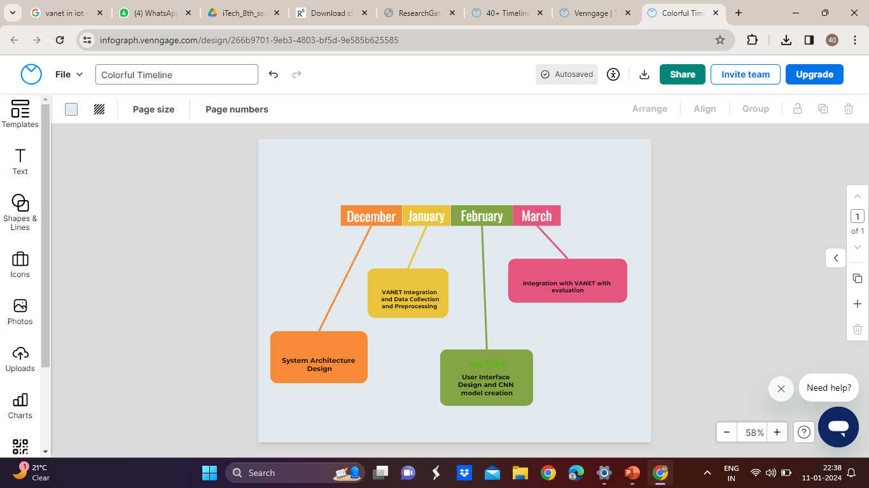
Timeline
Model evaluation and testing
Data collection
and svm model design
User Interface
AI based Vehicle Parking System in VANET

Slide 14
Roles and Responsibilities
Reshmah C S
1. System Architecture Design
2. SVM Model
3. Data Preprocessing
Swathy S
1.Data Collection
2. Training and Validation
3. Model development
Mugilan G
1. Software Implementation
2. User Interface Design
AI based Vehicle Parking System in VANET

Slide 15
Conclusions and Future work
In conclusion, the integration of HOG and SVM models in a vehicle parking system represents a promising advancement in smart transportation and urban management.
This synergy harnesses the power of real-time communication among vehicles and the sophisticated pattern recognition capabilities of SVM and HOG for effective parking space management.
The developed system facilitates seamless navigation for drivers, optimizes parking space utilization, and contributes to overall traffic efficiency.
The future works may include energy efficiency implementation by considering the power constraints of the vehicles.
Implementing edge computing to process data makes the decision making easier.
AI based Vehicle Parking System in VANET

Slide 16
References
[1] S. Hossain and X. Lin, "Short-range and Long-range Obstacle Detection Method for a Delivery Robot Based on Multi-sensor Fusion," 2023 IEEE Transportation Electrification Conference & Expo (ITEC), Detroit, MI, USA, 2023, pp. 1-5, doi: 10.1109/ITEC55900.2023.10186935
[2] C. Liu, L. Zhai and X. Zhang, "Research on local real-time obstacle avoidance path planning of unmanned vehicle based on improved artificial potential field method," 2022 6th CAA International Conference on Vehicular Control and Intelligence (CVCI), Nanjing, China, 2022, pp. 1-6, doi: 10.1109/CVCI56766.2022.9964763
[3] A. Kumari, H. R. Daksh, A. Utsav and A. Abhishek, "Self-Automated Car with Obstacles Detection," 2022 13th International Conference on Computing Communication and Networking Technologies (ICCCNT), Kharagpur, India, 2022
[4] Tanti, Hardik & Kasodariya, Pratik & Patel, Shikha & Rangrej, Dhaval. (2020). Smart Parking System based on IOT. International Journal of Engineering Research
[5] Pomaji, Amol & Boinwad, Suraj & Wankhede, Shrikant & Singh, Pushpendra & Dhakulkar, Bhagyashree. (2019). Smart Parking Management System. International Journal of Computer Sciences and Engineering.
AI based Vehicle Parking System in VANET

Slide 17
Thank You!

